Slide 1
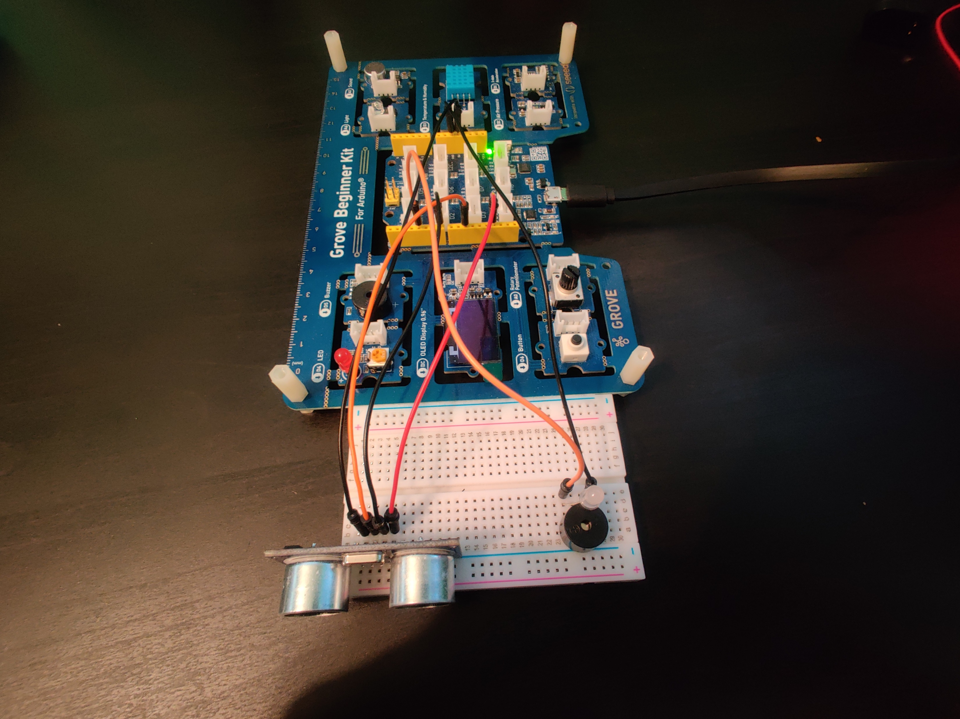
Grove Board
Button
Ultrasonic sensor
Buzzer

